Slide 1


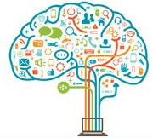



UNIT I | COMPUTATIONAL THINKING | 6
Computational Thinking – Modern Computer - Information based Problem solving– Real world information and Computable Data – Data types and data encoding - Number Systems – Introduction to programming languages - Basics of C programming – variables- data types – keywords – C program structure - simple programs in C
25 November 2021
KPR Institute of Engineering and Technology, Coimbatore, Tamil Nadu, India
1
Notes:
1

Slide 2
The C Programming Language
Who? Dennis Ritchie
When? ~1972
Where? Bell Labs
Why? Build the Unix OS
25 November 2021
KPR Institute of Engineering and Technology, Coimbatore, Tamil Nadu, India
1
Notes:
1

Slide 3
C: History
25 November 2021
KPR Institute of Engineering and Technology, Coimbatore, Tamil Nadu, India
1
Notes:
1

Slide 4
Design Goals
25 November 2021
KPR Institute of Engineering and Technology, Coimbatore, Tamil Nadu, India
1
Notes:
1

Slide 5
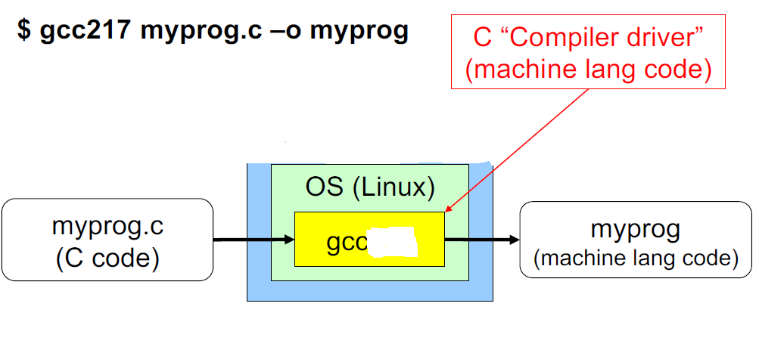
Building C Programs
25 November 2021
KPR Institute of Engineering and Technology, Coimbatore, Tamil Nadu, India
1
Notes:
1

Slide 6
Running C Programs
$ ./myprog
25 November 2021
KPR Institute of Engineering and Technology, Coimbatore, Tamil Nadu, India
1
Notes:
1

Slide 7
C: Details
25 November 2021
KPR Institute of Engineering and Technology, Coimbatore, Tamil Nadu, India
1
Notes:
1

Slide 8
Cont.,
25 November 2021
KPR Institute of Engineering and Technology, Coimbatore, Tamil Nadu, India
1
Notes:
1

Slide 9
Cont.,
25 November 2021
KPR Institute of Engineering and Technology, Coimbatore, Tamil Nadu, India
1
Notes:
1

Slide 10
Cont.,
25 November 2021
KPR Institute of Engineering and Technology, Coimbatore, Tamil Nadu, India
1
Notes:
1

Slide 11
Cont.,
25 November 2021
KPR Institute of Engineering and Technology, Coimbatore, Tamil Nadu, India
1
Notes:
1

Slide 12
Cont.,
25 November 2021
KPR Institute of Engineering and Technology, Coimbatore, Tamil Nadu, India
1
Notes:
1

Slide 13
Cont.,
25 November 2021
KPR Institute of Engineering and Technology, Coimbatore, Tamil Nadu, India
1
Notes:
1

Slide 14
Example C Program
25 November 2021
KPR Institute of Engineering and Technology, Coimbatore, Tamil Nadu, India
1
Notes:
1

Slide 15
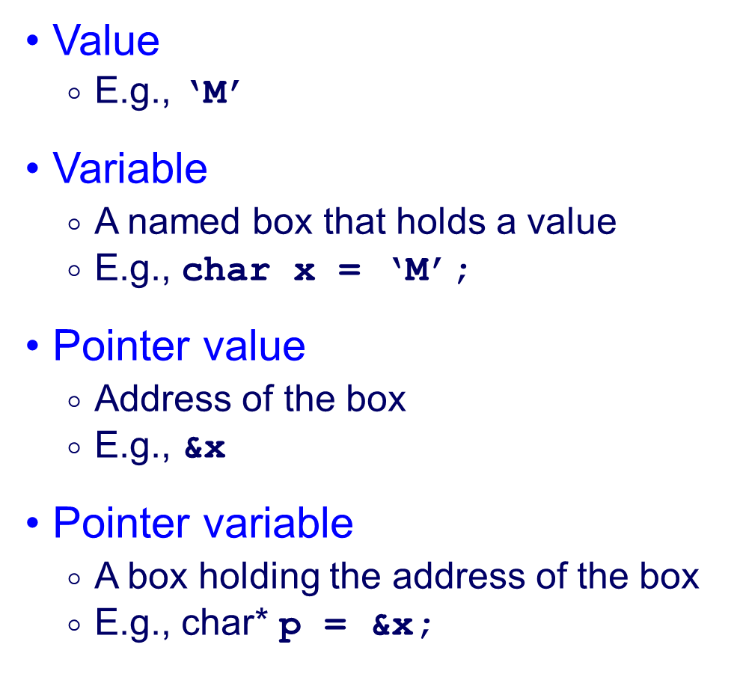
Values, Variables, and Pointers
memory
‘s’
‘M’
x
‘o’
‘o’
‘t’
p
&x
‘h’
‘y’
25 November 2021
KPR Institute of Engineering and Technology, Coimbatore, Tamil Nadu, India
1
Notes:
1

Slide 16
Example Program
#include <stdio.h>
int main(void) {
char x = ‘M’;
char* p = &x;
printf(“Value of x is %c\n”, x);
printf(“Address of x is %u\n”, p);
printf(“Address of p is %u\n,” &p);
return 0;
}
Output
Value of x is M
Address of x is 4290770463
Address of p is 4290770456
What is this?
*p
25 November 2021
KPR Institute of Engineering and Technology, Coimbatore, Tamil Nadu, India
1
Notes:
1

Slide 17
Values vs. Variables
int n;
n = 217;
n = n + 9;
3 = n;
&n a pointer value
&3
What is this?
*(&n)
25 November 2021
KPR Institute of Engineering and Technology, Coimbatore, Tamil Nadu, India
1
Notes:
1

Slide 18
Character Literals
25 November 2021
KPR Institute of Engineering and Technology, Coimbatore, Tamil Nadu, India
1
Notes:
1

Slide 19
Choosing names for variables, functions, macro, and other entities
Starts with letter or underscore
Identifiers
25 November 2021
KPR Institute of Engineering and Technology, Coimbatore, Tamil Nadu, India
1
Notes:
1

Slide 20
Group of characters that cannot be split up without changing their meaning
Identifiers and keywords are tokens
+,- and punctuation marks like comma and semicolon and string literals
Tokens
25 November 2021
KPR Institute of Engineering and Technology, Coimbatore, Tamil Nadu, India
1
Notes:
1

Slide 21
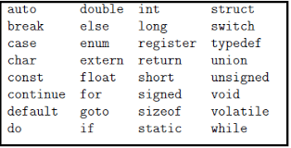
Keywords
25 November 2021
KPR Institute of Engineering and Technology, Coimbatore, Tamil Nadu, India
1
Notes:
1

Slide 22
Data Types in C
25 November 2021
KPR Institute of Engineering and Technology, Coimbatore, Tamil Nadu, India
1
Notes:
1

Slide 23
Primitive Data Types
25 November 2021
KPR Institute of Engineering and Technology, Coimbatore, Tamil Nadu, India
1
Notes:
1

Slide 24
Integer Data Types
25 November 2021
KPR Institute of Engineering and Technology, Coimbatore, Tamil Nadu, India
1
Notes:
1

Slide 25
Integer Literals
25 November 2021
KPR Institute of Engineering and Technology, Coimbatore, Tamil Nadu, India
1
Notes:
1

Slide 26
Unsigned Integer Data Types
25 November 2021
KPR Institute of Engineering and Technology, Coimbatore, Tamil Nadu, India
1
Notes:
1

Slide 27
Unsigned Integer Literals
25 November 2021
KPR Institute of Engineering and Technology, Coimbatore, Tamil Nadu, India
1
Notes:
1

Slide 28
“Character” Data Type
25 November 2021
KPR Institute of Engineering and Technology, Coimbatore, Tamil Nadu, India
1
Notes:
1

Slide 29
Character Literals
25 November 2021
KPR Institute of Engineering and Technology, Coimbatore, Tamil Nadu, India
1
Notes:
1

Slide 30
Strings and String Literals
25 November 2021
KPR Institute of Engineering and Technology, Coimbatore, Tamil Nadu, India
1
Notes:
1

Slide 32
Arrays of characters
25 November 2021
KPR Institute of Engineering and Technology, Coimbatore, Tamil Nadu, India
1
Notes:
1

Slide 33
Unicode
25 November 2021
KPR Institute of Engineering and Technology, Coimbatore, Tamil Nadu, India
1
Notes:
1

Slide 34
Logical Data Types
25 November 2021
KPR Institute of Engineering and Technology, Coimbatore, Tamil Nadu, India
1
Notes:
1

Slide 35
Logical Data Type Shortcuts
25 November 2021
KPR Institute of Engineering and Technology, Coimbatore, Tamil Nadu, India
1
Notes:
1

Slide 36
Floating-Point Data Types
25 November 2021
KPR Institute of Engineering and Technology, Coimbatore, Tamil Nadu, India
1
Notes:
1

Slide 37
Floating-Point Literals
25 November 2021
KPR Institute of Engineering and Technology, Coimbatore, Tamil Nadu, India
1
Notes:
<number>

